Slide 1
Unit 5 and 6 Review
Modern 1750-1900 and Contemporary 1900- Present

Slide 2
5.
Modern
1750-1900

Slide 4
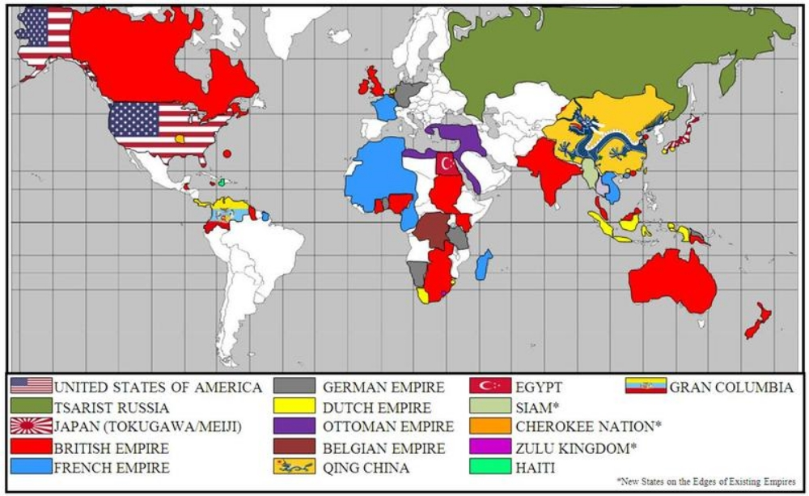

Slide 5
6.
Contemporary
1900- Present

Slide 7
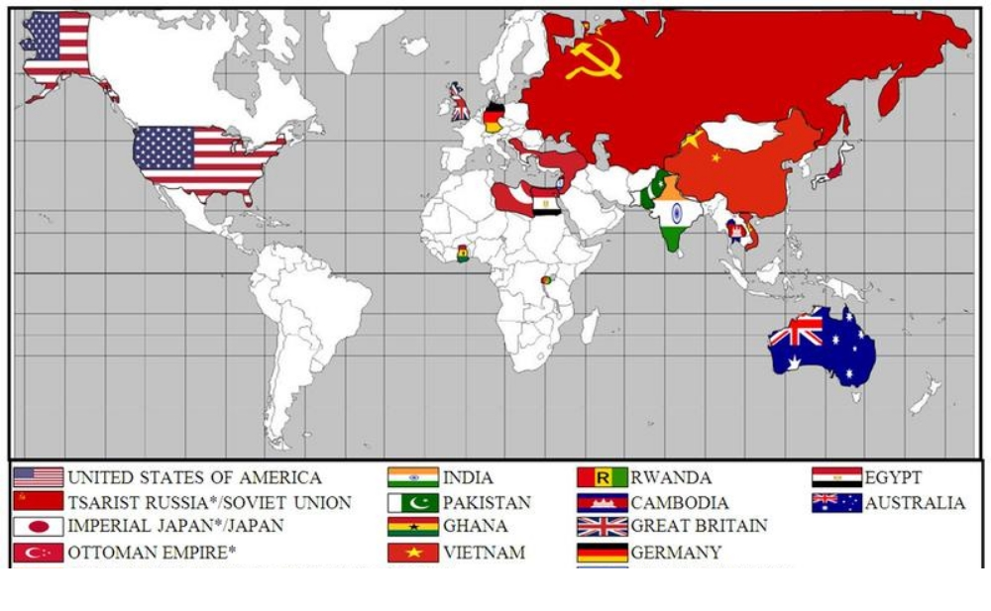

Slide 8
SAQ
Use the excerpt below and your knowledge of world history to answer all parts of the question that follows.
“We are, moreover, neither Indian nor European, but a species midway between the legitimate proprietors of this country and the Spanish usurpers. In short, though Americans by birth we derive our rights from Europe, and we have to assert these rights against the rights of the natives, and at the same time we must defend ourselves against the invaders. This places us in a most extraordinary and involved situation…
The role of the inhabitants of the American hemisphere has for centuries been purely passive. Politically they were nonexistent. We are still in a position lower than slavery, and therefore it is more difficult for us to rise to the enjoyment of freedom… We have been harassed by a conduct which has not only deprived us of our rights but has kept us in a sort of permanent infancy with regard to public affairs.”
The Jamaica Letter, Simón Bolívar, 1815
1. Answer parts a, b, and c.
Identify and explain ONE example of how Bolívar’s Jamaica Letter represented Enlightenment ideals.
Identify and explain ONE issue seen in the Jamaica Letter that caused the Latin American Revolutions.
Identify and explain an ADDITIONAL cause of the Latin American Revolutions.

Slide 9
Mind Map

Slide 10
Muhammed Ali
Berlin Conference
Raj
Abolitionist
Otto von Bismarck
Simon Bolivar
Australia
Conservative
Liberal
Radical
Steam engine
French Revolution
American Revolution
Haitian Revolution
Latin American Revolution
Napoleon
Jose de San Martin
Reign of Terror
Nationalism
Bourgeoisie
Tropical dependency
Isolationist
Daimyo
Scramble for Africa
Sepoy
Cecil Rhodes
Suez Canal
Imperialism
Caudillos
Monroe Doctrine
Spanish American War
Industrial Revolution
Interchangeable parts
Laissez-faire
Karl Marx
Adam Smith
Proletariat
Socialism
James Watt
Boxer rebellion
Catherine the Great
Duma
Meiji
Opium Wars
Matthew Perry
Green Revolution Petroleum Nuclear power Ottoman collapse Russian collapse Qing collapse Holocaust World War I World War II Total war Fascism Nationalism Deng Xiaoping Ronald Reagan Mohandas Gandhi Margaret Thatcher Ho Chi Minh Tiananmen Square Apartheid Kwame Nkrumah | Communism Great Depression Cold War United States Soviet Union NATO Capitalism Warsaw Pact Proxy Wars Non-Aligned Movement Communist China Free-market economy Nelson Mandela

